Slide 1
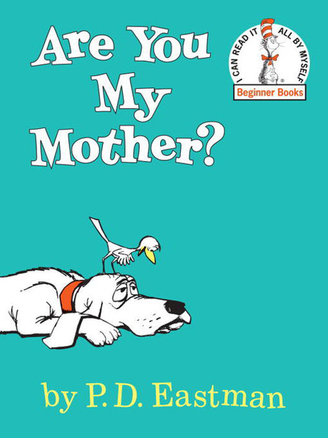
Are You My Mother?
Written By P.D. Eastman
Read By Misty Epperson

Slide 2
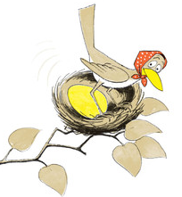
A mother bird sat on her egg. The egg jumped!

Slide 3
“I must get something for my baby bird to eat!” she said. So away she went.

Slide 4
Inside the nest, the egg jumped. It jumped and jumped and jumped. Until…. Out came a baby bird!

Slide 5
“Where is my mother? He said. He did not see her anywhere. “I will go and look for her,” he said.

Slide 6
Out of the nest he went. Down, down, down! Plop!

Slide 7
The baby bird could not fly. He could walk. “Now I will go and find my mother,” he said.

Slide 8
“Are you my mother?” the baby bird asked a kitten. The kitten just looked and looked. It did not say a thing.

Slide 9
“Are you my mother?” the baby bird asked a hen. “No,” said the hen.

Slide 10
“Are you my mother?” the baby bird asked a dog. “I am not your mother. I am a dog,” said the dog.

Slide 11
“Are you my mother?” the baby bird asked a cow. “How could I be your mother?” said the cow. “I am a cow.”

Slide 12
The baby bird stopped to think. The kitten and the hen were not his mother. The dog and the cow were not his mother. “I have a mother,” said the baby bird. “I know I do. I will find her. I will. I WILL!”

Slide 13
Just then the baby bird saw a big thing. “You are my mother!” he said. The big thing said, “SNORT!”

Slide 14
“Oh no!” said the baby bird. “You are not my mother. You are a scary Snort!” The Snort lifted the baby bird up, up, up.

Slide 15
Then something happened. The Snort put the baby bird right back in the tree. The baby bird was home!

Slide 16
Just then the mother bird came back. “I know who you are,” said the baby bird.

Slide 17
“You are not a kitten or a hen or a dog. You are not a cow or a Snort! You are a bird, and you are my mother!”

Slide 18
The End

